Slide 1
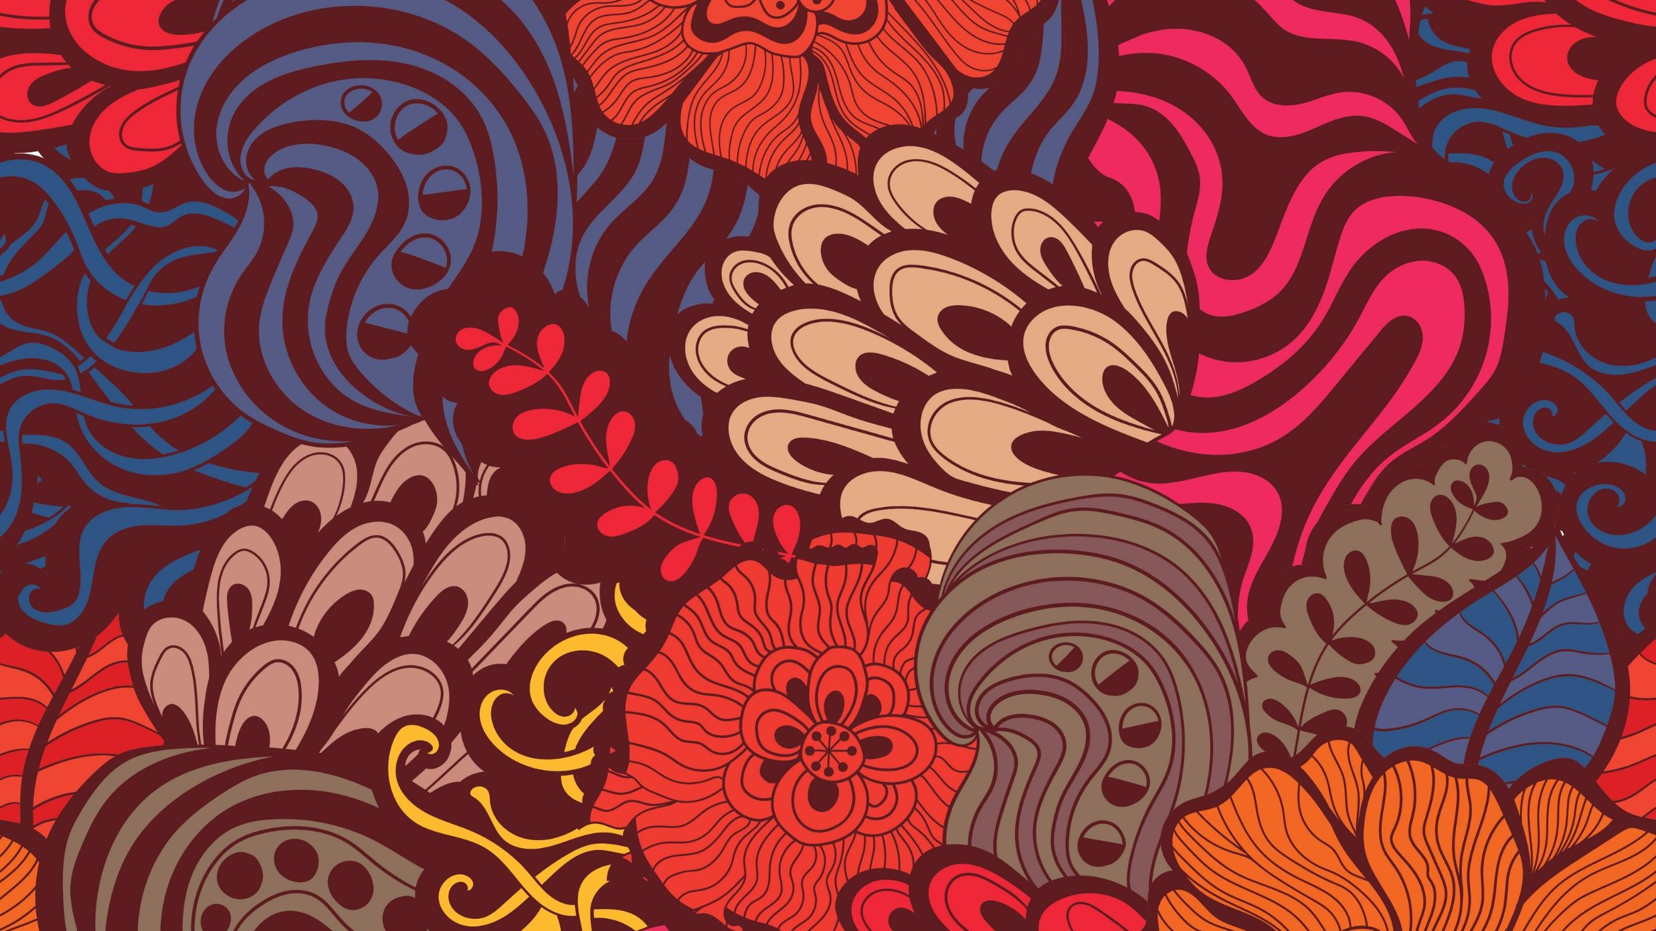
Art style transfer
Juan Pablo Velazco
André Calderon
Daniel Ortiz Joachin

Slide 2
What is style transfer?
Take 2 pictures (One of a style and one to be transfer too). Identify the abstraction in the style and apply it to the second image
It is performed by optimizing the input image, not the model.

Slide 3
VGG-19
It is a pre-trained model for object classification.
It helps us keep to content image somewhat similar

Slide 4
How it works
Find the loss function of the style, which is the gram matrix of the style minus the gram matrix of the input style squared.
The content loss are the later layers of the model.
Add these two loss functions and the total loss function is the result.

Slide 5
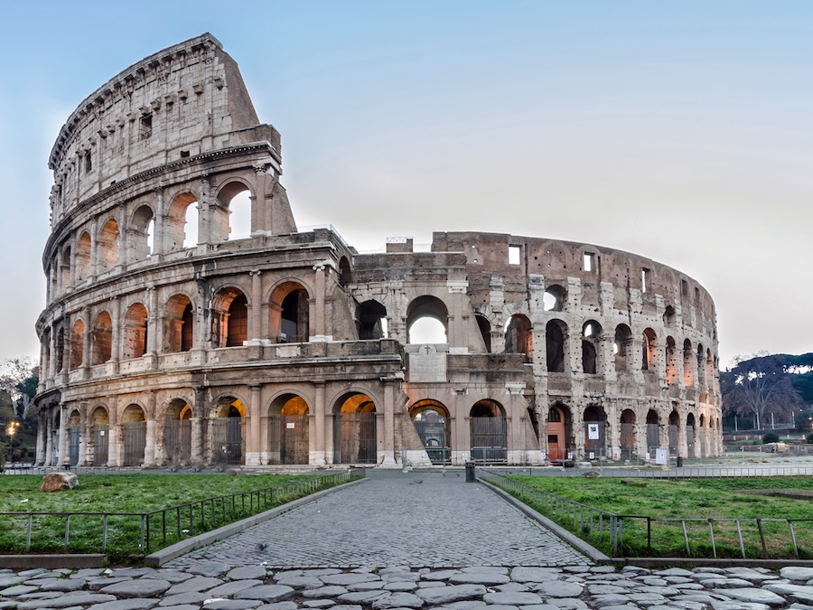
Content image

Slide 6
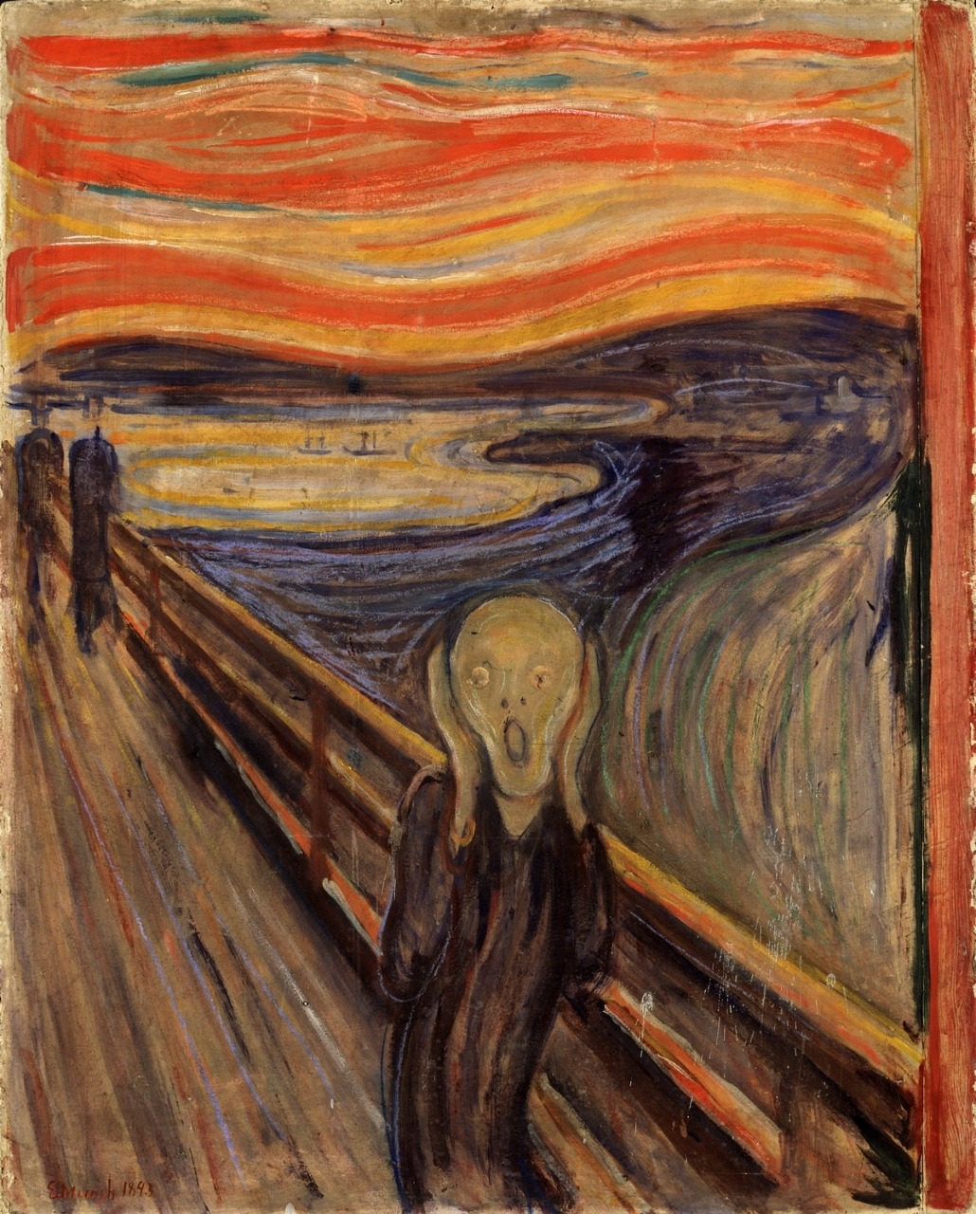
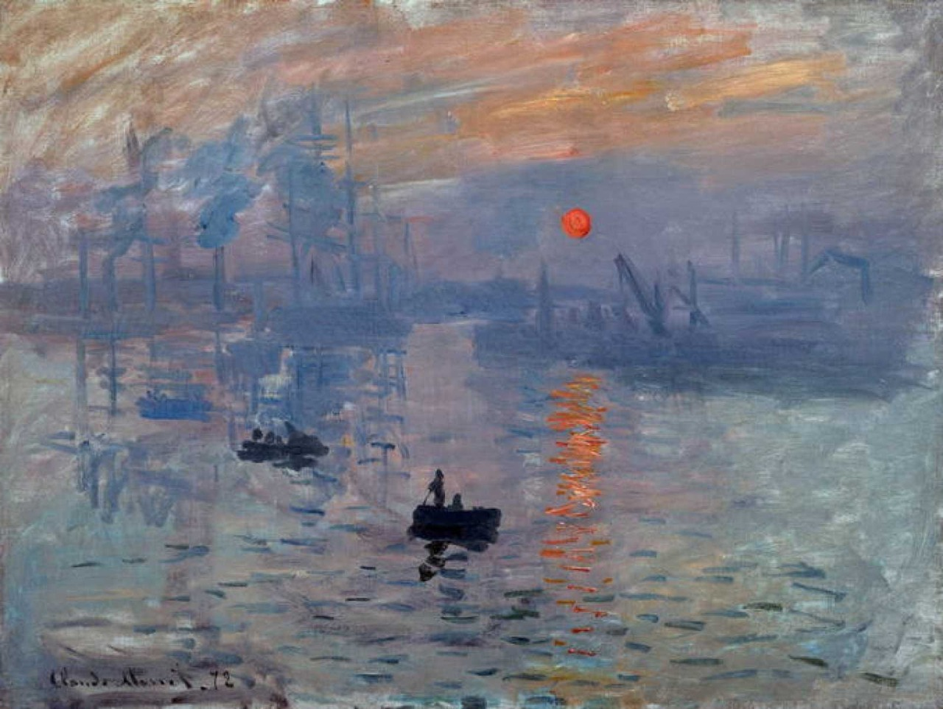
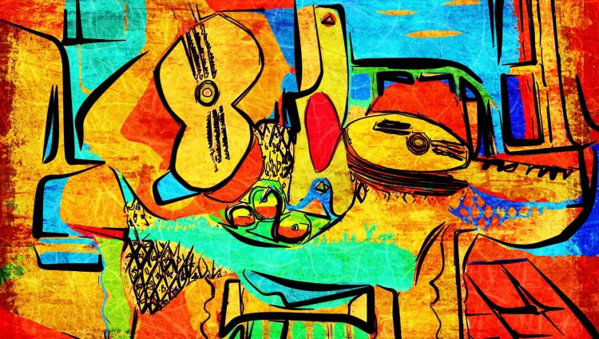
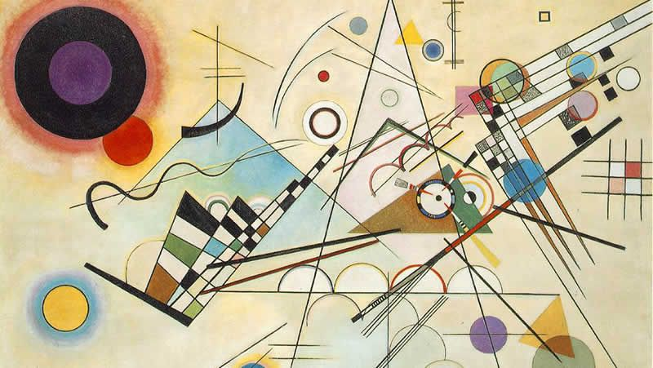

Style Images

Slide 7
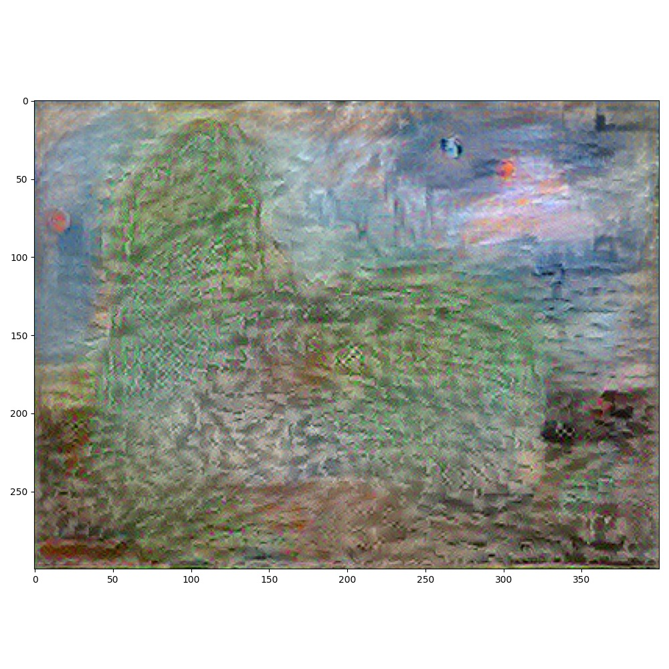
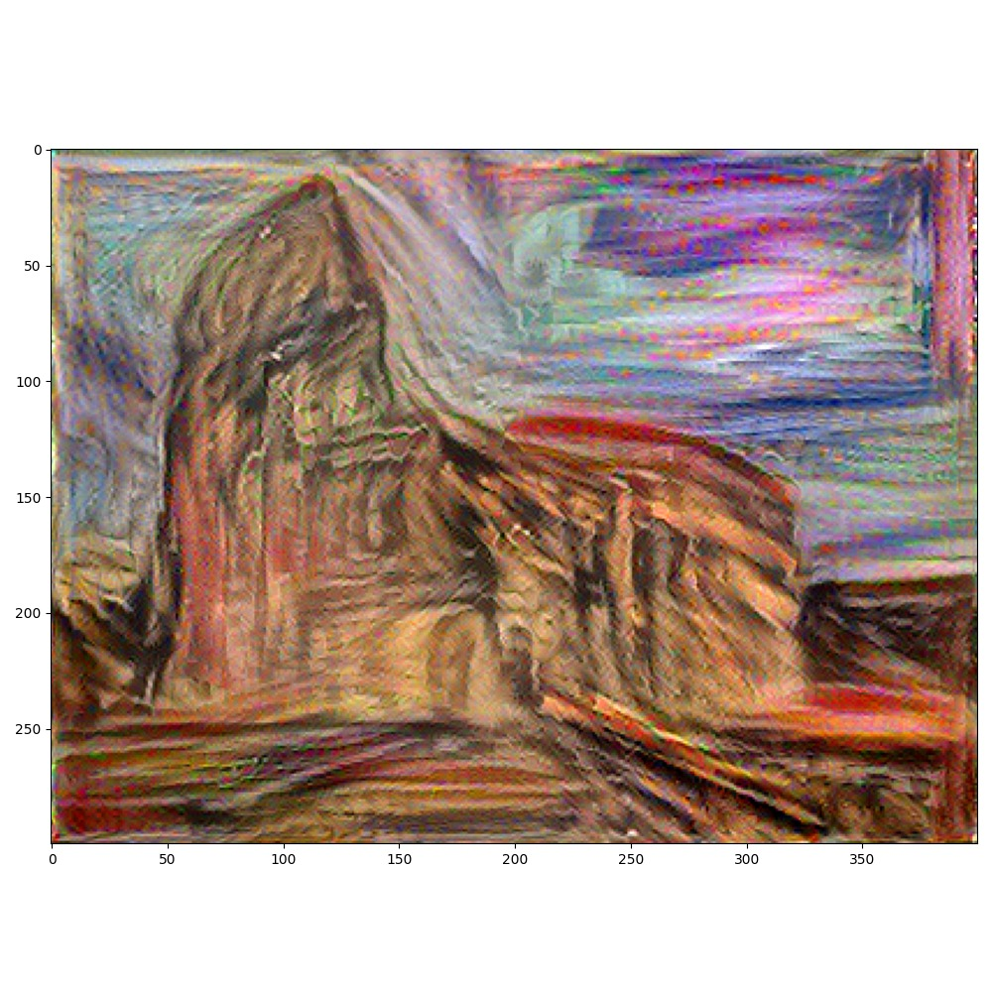
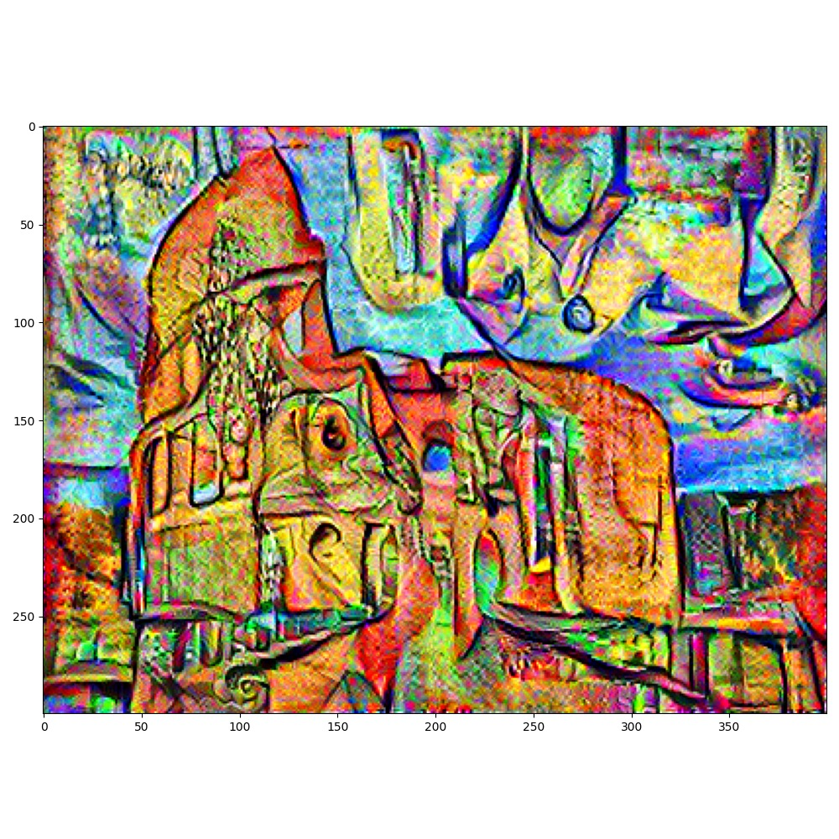
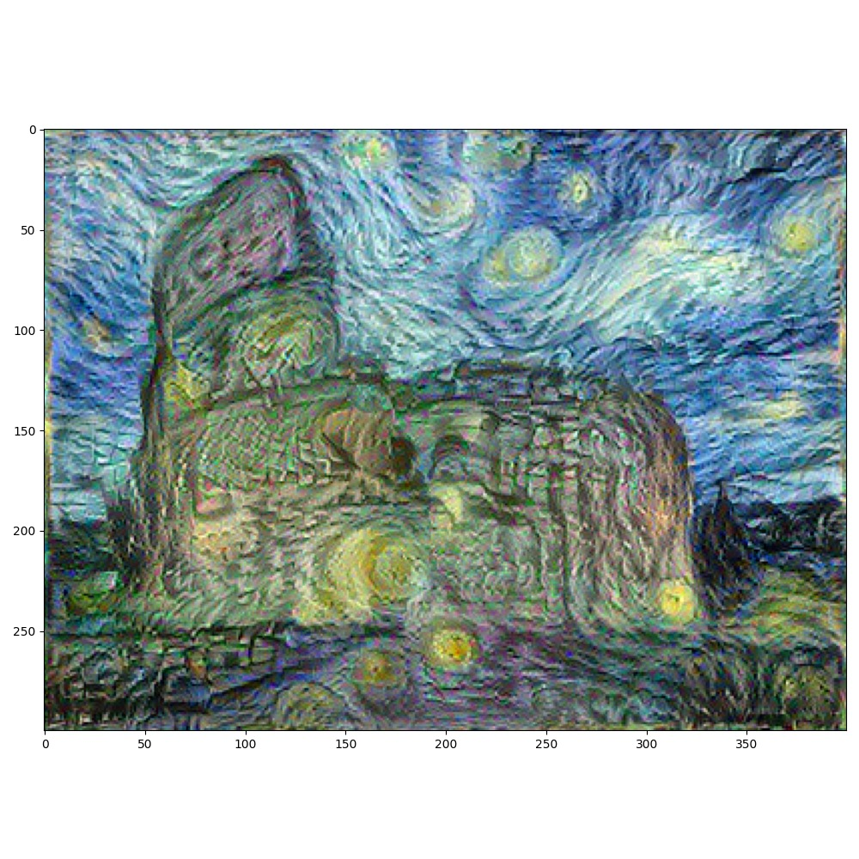
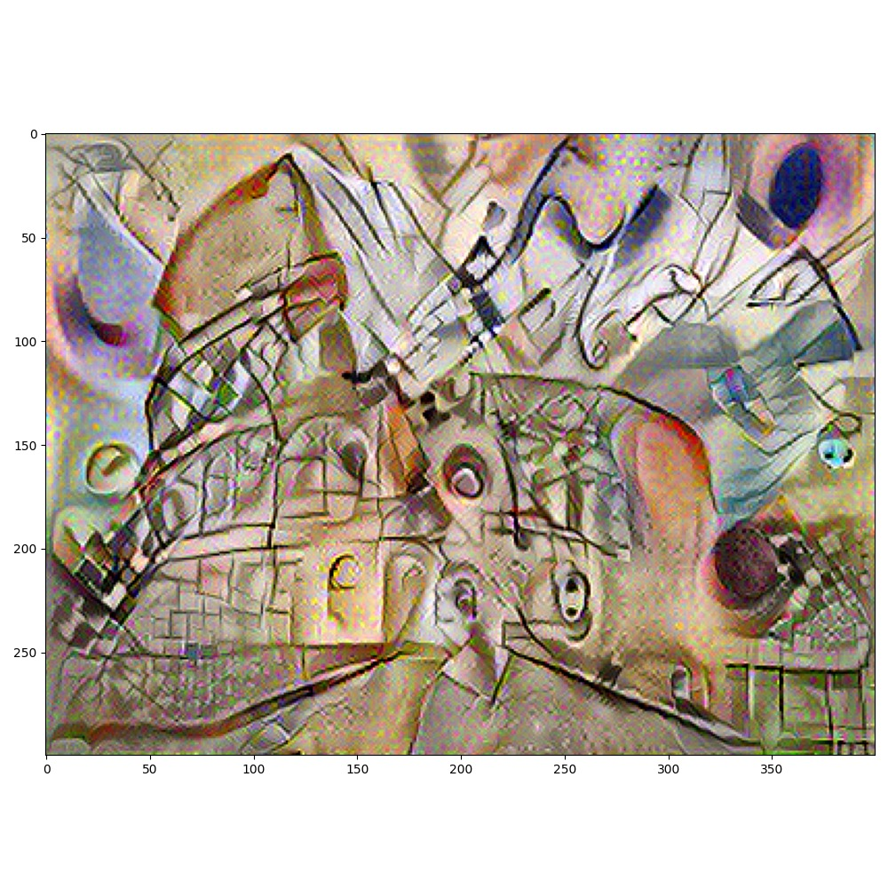
Resulting images

